Slide 1
Evaluation of Airport Capacity through Agent Based Simulation
Y. Peng et al.

Slide 2
Improving airport capacity
Airport capacity → avarage number of movements that can be performed on the taxiway in one hour
How to improve capacity? An agent based simulation capable of solving conflicts on the taxiway

Slide 3
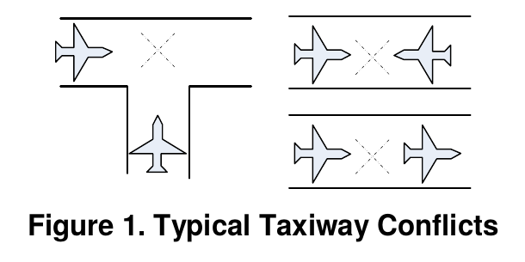
Conflicts

Slide 4
Model Description :
Agent Types
Aircrafts
Network→ store info of the traffic network
Junction→ assist network in updating infos about one particular junction
Interaction→ assists aircraft to get info about the surroundings of a junction
Ground control→ provides initial routing
Runway
Apron→ stores parked aircrafts

Slide 5
Model Description:
Deconfliction algorithm
Conflict may occur despite the application of an effective routing algorithm because of some stochastic perturbation of the movemen
Deconfliction is operated by aircraft agents thanks to the information exchange with Interaction agents

Slide 6
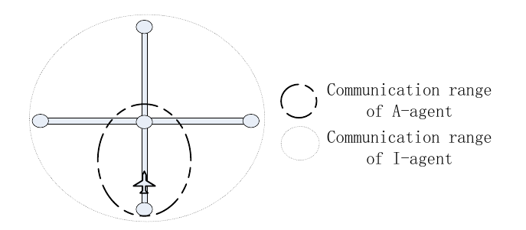
Model Description:
Deconfliction algorithm

Slide 7
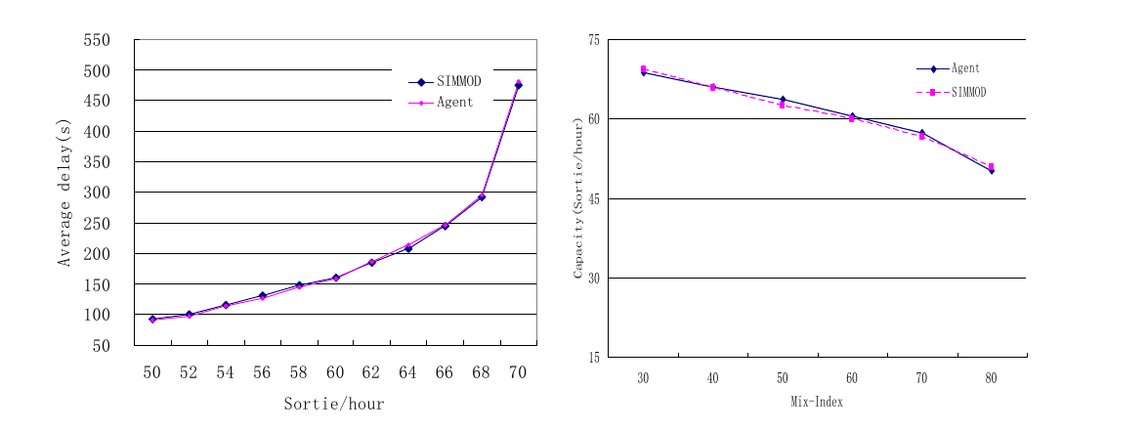
Results: comparison with SIMMOD model

Slide 8
Results: percentage of delay

Slide 9
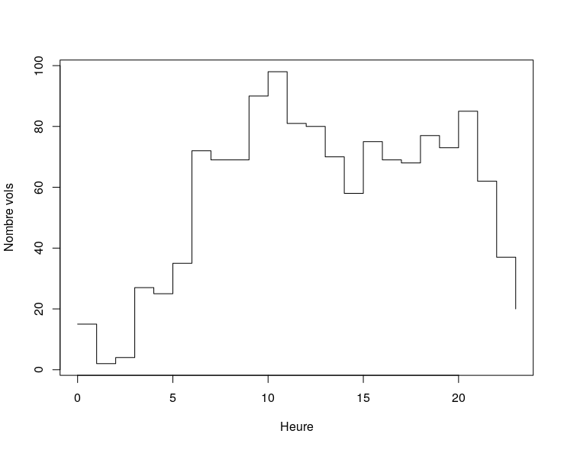
CDG capacity

Slide 10
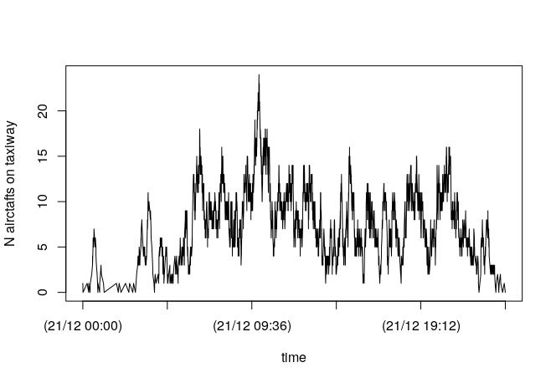
My results
→ The maximum number of aircrafts on the taxiway is 24
→ High traffic periods alternate with low traffic periods quite quickly.

